Slide 1
Software Requirements

Slide 2
Software Requirements
Descriptions and specifications of a system

Slide 3
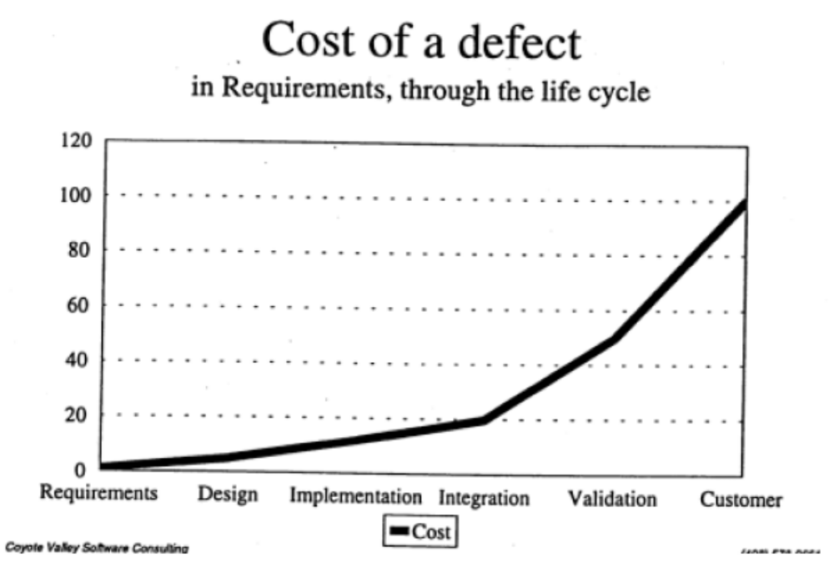
需求的重要性

Slide 4
对需求的要求
标识
  唯一地标识需求各个语句的能力
  以多种方式对需求的各个语句的分类能力
    按重要性分类
    按类型分类（例如功能、性能、约束、安全性）
    按紧急程度分类
分类
  跟踪每个需求语句状态的能力，以支持多个过程；例如：
  评审状态；满足状态；鉴定状态
跟踪
以多种方式详细描述需求的能力：
  性能信息，鉴定，测试准则，根本原因，注释
详细描述
在文档总体背景下研究需求描述的能力，即考虑与其相关的描述
根据具体分类或背景，浏览整个需求文档并找出需求的能力
跟踪任何单个需求语句的能力
其他

Slide 5
需求的分类-1
功能需求
性能需求
界面需求
接口需求
资源需求（管理方面的需求）
潜在需求（potential requirements）等

Slide 6
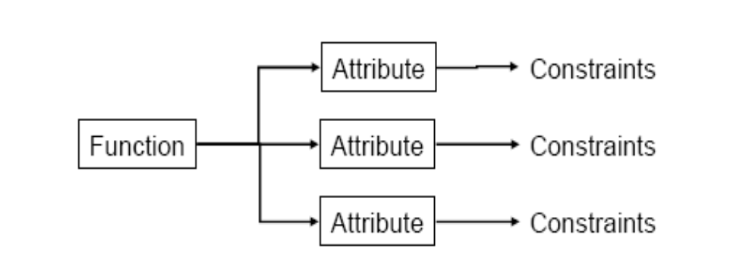
功能性需求
功能
  做什么
  采用动词描述
  存在也是一种功能
  可观察不可度量
属性
  功能的特征
  形容词或者副词
  可度量
约束
  属性的边界
  可度量,可测试
绿色

Slide 7
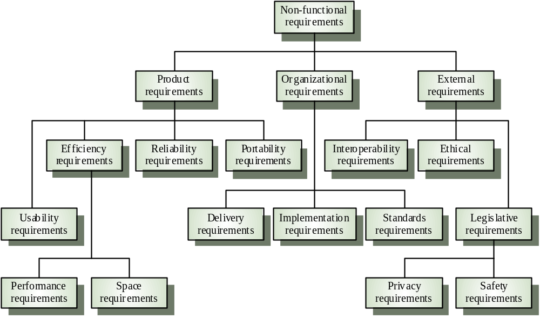
Non-functional requirement types

Slide 8
需求的分类-3 需求的层次
 | 提出者 | 获取方法 | 文档量 | 文档形式 | 评审方式 | 稳定性 | 返工影响
目标需求 | 高层经理 | 访谈 | 几页 | ppt,word | 正规评审会 | 最稳定 | 最大
业务需求 | 中层经理 | 访谈 | 几十页 | excel,word | 正规评审会 | 较稳定 | 次之
操作需求 | 操作员 | 原型 | 几十页,上百页 | word | 非正式评审会,正规评审会,分多次评审 | 最易变化 | 局部影响

Slide 9
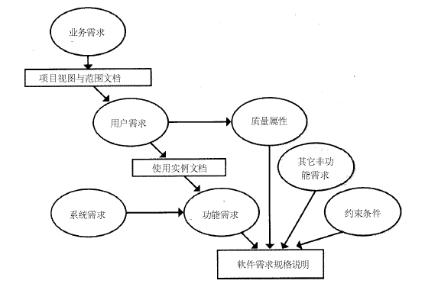
需求的分类-4 需求的层次

Slide 10
需求的分类-5
客户、产品及产品构件的需求
客户需求
最终用户
可操作概念及场景
市场
客户
产品及产品 构件的需求
导出的需求
客户
合作经理及 管理部门
功能分析
项目相关人员

Slide 11
需求的分类-6
客户、产品及产品构件的需求
客户需求
硬件工程
最终用户
分配给硬件等
的产品需求
市场
软件工程
客户
产品及产品 构件的需求
客户
机械工程
合作经理及 管理部门
项目相关人员
其他组

Slide 12
需求的分类-7
全局性需求与局部需求
全局性需求
  影响的面比较广,一旦发生变更,工作量比较大
  例如:
    系统中物料的编码规则
    整个系统对操作员权限的限定
      数据权限
      功能权限
      时间权限
      部门权限
局部需求
  影响的范围比较小

Slide 13
需求的分类-8
易见性
  明显的
  隐藏的
迫切性
  必须的
  希望的
  装饰性的

Slide 14
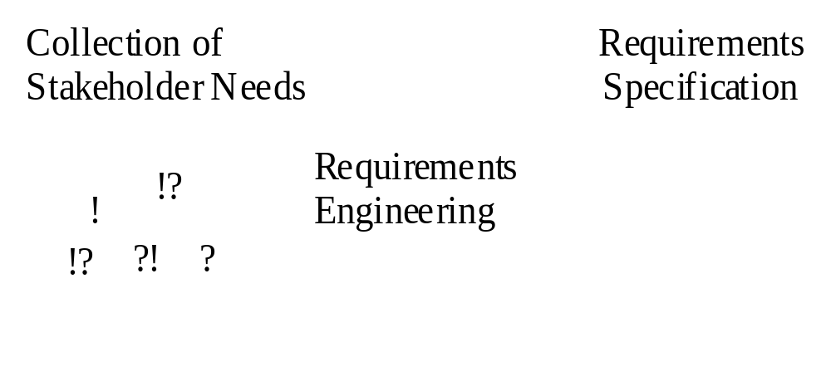
Requirements Engineering
Establishes the services the customer requires from a system and the constraints under which it operates and is developed
Requirements are descriptions of the system services and constraints generated during requirements engineering

Slide 15
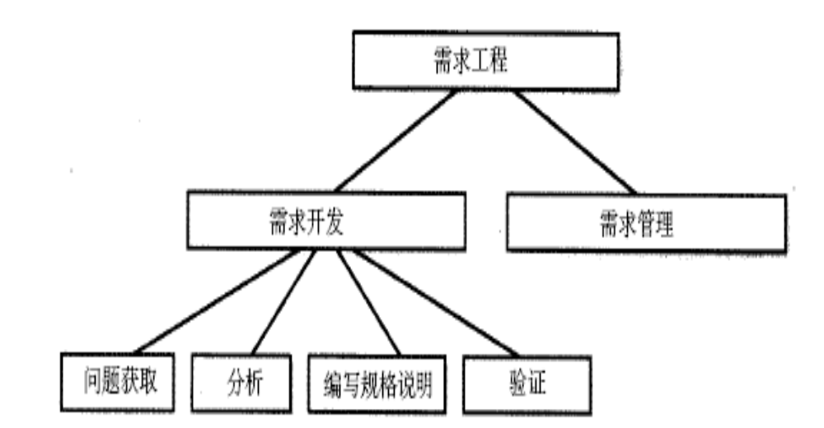
需求工程的内容

Slide 16
需求获取
需求获取的指导原则(针对信息系统)
  深入浅出
  以流程为主线,贯串功能
需求获取的步骤
  了解概况,收集资料
  识别合格的提供者
  准备问题
  调查或着访谈
  总结归纳,准备新的问题,迭代
注意
  要从系统的整个生命周期过程来考虑需求

Slide 17
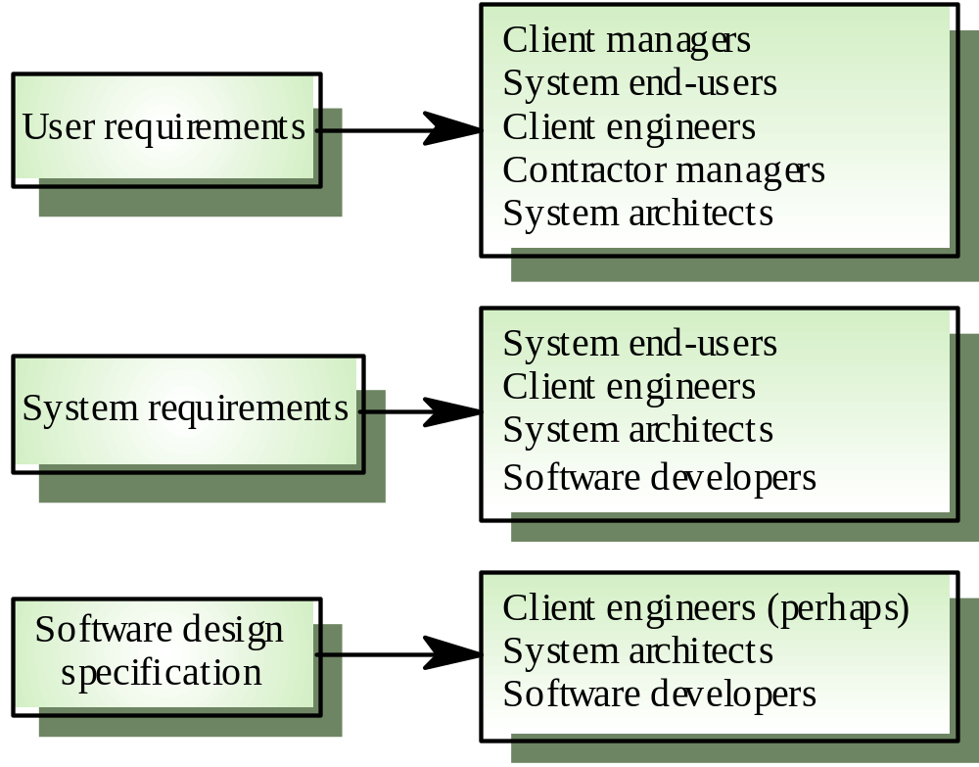
Requirements Readers

Slide 18
需求分析
需求分析的思维方式
  穷举:确保无遗漏
  分类:去除冗余的需求
  分层:结构化表达
  抽象:识别最稳定的成分
需求分析的方法
  结构化方法
  OO的方法

Slide 19
需求描述
需求描述的方面(针对信息系统):
  组织结构与职责分配 业务流程
  功能:可以采用USE CASE描述 界面原型
  数据 处理规则
  其他约束等 及上述7个方面的关系
需求描述的文档格式
  PPT EXCEL
  WORD ROSE
注意
  需求描述详细到什么程度?

Slide 20
需求验证
分层次评审
正式评审与非正式评审结合
分阶段评审
精心挑选评审员
对评审员进行培训
充分利用需求评审检查单
充分准备评审
定义评审结束的条件
做好评审后的跟踪工作
建立标准的评审流程

Slide 21
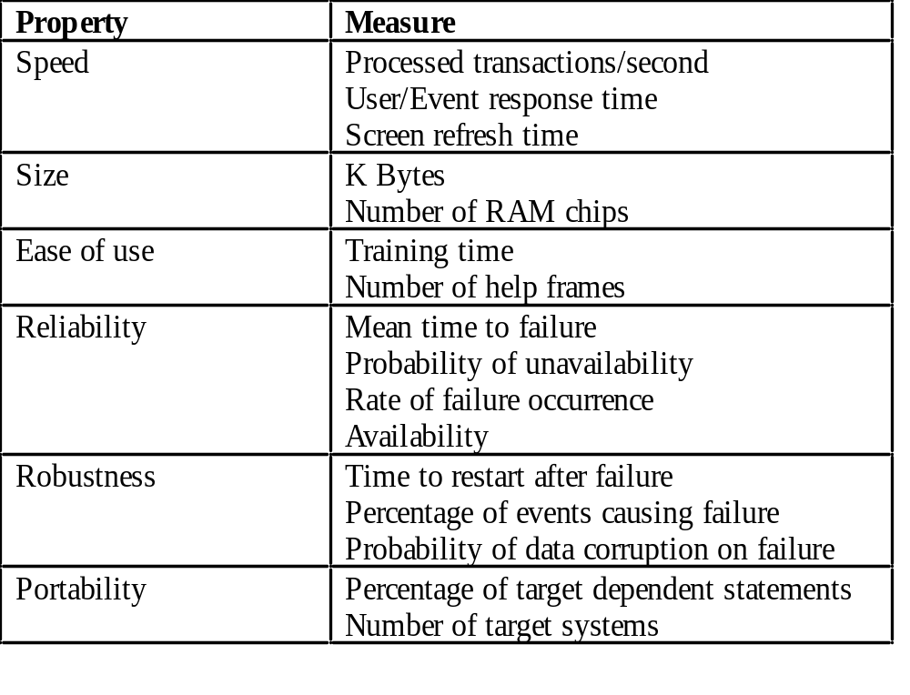
Requirements Measures

Slide 22
需求管理
需求的变化是永恒的
需求的变化是积少成多的
需求管理的基本原则
  需求必须划分优先级
  需求变更的成本谁来承担?
  小的需求变更也要纳入正规的流程
  不同层次的需求变更流程不同
  需求变更后

Slide 23
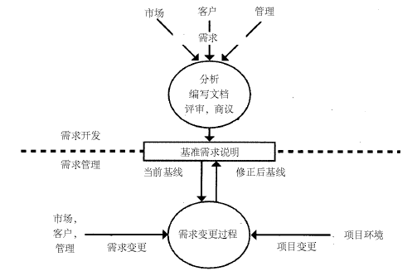
需求开发与需求管理的关系
图2-3

Slide 24
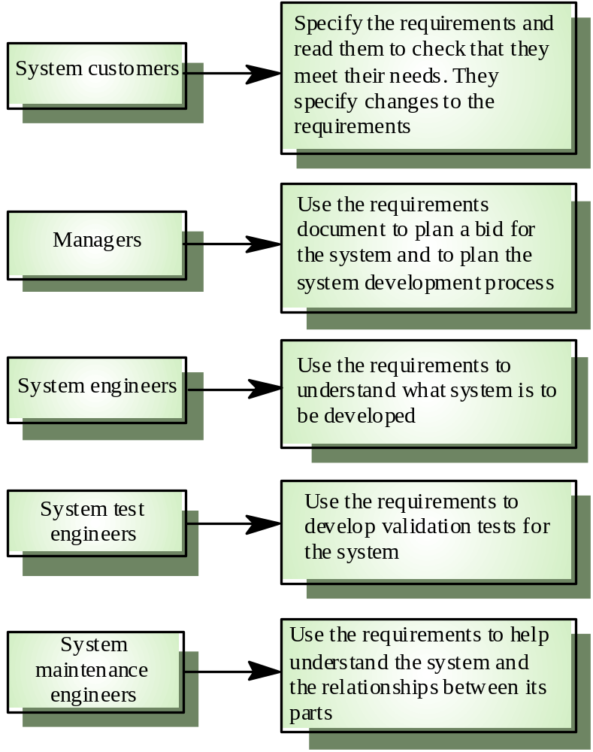
Stakeholders

Slide 25
练习：需求评审
目标管理系统的客户需求文档

Slide 26




How does COTS change things?
Traditional Approach
(Waterfall Development)
Required COTS Approach
requirements
cost
schedule
business processes
operational procedures, etc.
System
Context
System Context
Simultaneous
Definition
and Tradeoffs
Architecture & Design
Implementation
Marketplace
Architecture & Design
COTS products
NDI
standards
Strongly influenced by products
Build from Scratch
Buy, Integrate, Continuously Refresh

Slide 27
Spheres of Control
(Variable) desires
of stakeholders
genuine needs
needs
needs that
that
may
be
can
not
be
fulfilled
fulfilled
Requirements
Expectations
Exclusions
Requirements
Requirements
Beyond the Requirements engineer's
Sphere of control (e.g., laws of physics,
limits of technology, and available resources)
engineer’s
engineer’s
sphere of control
sphere of
influence

Slide 28
Effect of Components
(Variable) desires
Components found in
of stakeholders
the marketplace
genuine needs
Requirements
Expectations
Exclusions
Requirements
Requirements
Things that can
engineer’s
engineer’s
not be obtained
diminished
expanded
with existing
sphere of
sphere of
component technology
control
Hot Spot
influence

Slide 29
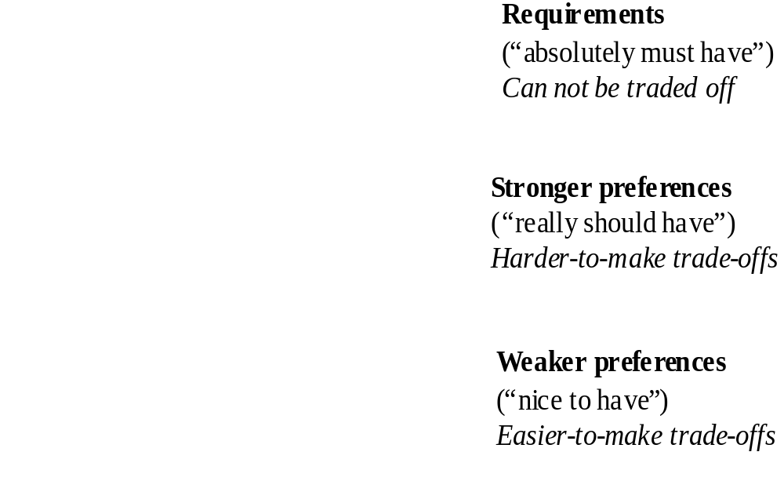
Requirements Centrifuge

Slide 30
Key Points 1
Requirements set out what the system should do and define constraints on its operation and implementation
Functional requirements specify services the system should provide
Non-functional requirements constrain the system being developed or the development process
User requirements are high-level statements of what the system should do

Slide 31
Key Points 2
User requirements should be written in natural language, tables and diagrams
System requirements
  are intended to communicate the functions that the system should provide
  may be written in
    structured natural language
    PDL
    formal language
A software requirements document is an agreed statement of the system requirements

Slide 32
System Models

Slide 33
System Models
Abstract descriptions of systems whose requirements are being analyzed

Slide 34
Objectives
Explain why the context of a system should be modeled as part of the requirements engineering process
Describe
  behavioral modeling
  data modeling
  object modeling
Show how CASE workbenches support system modeling

Slide 35
Topics Covered
Context models
Behavioral models
Data models
Object models
CASE workbenches

Slide 36
System Modeling
System modeling
  helps the analyst understand the functionality of the system
  models are used to communicate with customers
Different models present the system from different perspectives
  External - shows the system’s context or environment
  Behavioral - shows the behavior of the system
  Structural - shows the system or data architecture

Slide 37
Structured Methods
Structured methods incorporate system modeling as an inherent part of the method
Methods define
  a set of models
  a process for deriving these models
  rules and guidelines that apply to the models
CASE tools support system modeling as part of a structured method

Slide 38
#Method Weaknesses
Do not model non-functional system requirements
Do not usually include information about whether a method is appropriate for a given problem
May produce too much documentation
System models are sometimes too detailed and difficult for users to understand

Slide 39
Model Types
Data processing model showing how the data is processed at different stages
Composition model showing how entities are composed of other entities
Architectural model showing principal sub-systems
Classification model showing how entities have common characteristics
Stimulus/response model showing the system’s reaction to events

Slide 40
Context models
Context models are used to illustrate the boundaries of a system
Social and organizational concerns may affect the decision on where to position system boundaries
Architectural models show the a system and its relationship with other systems

Slide 41
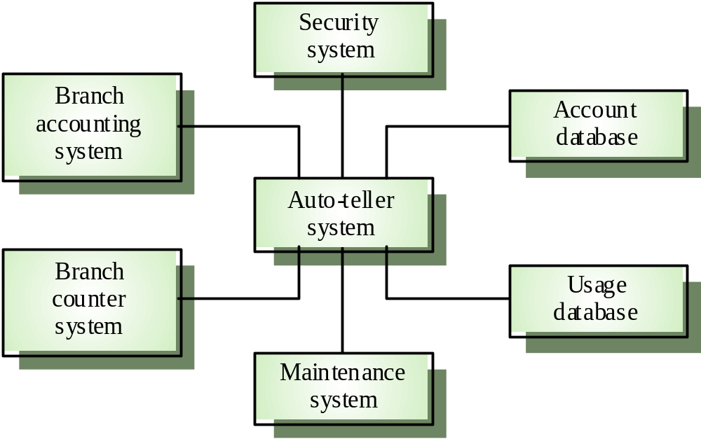
#The context of an ATM system

Slide 42
Process models
Process models show the overall process and the processes that are supported by the system
Data flow models may be used to show the processes and the flow of information from one process to another

Slide 43
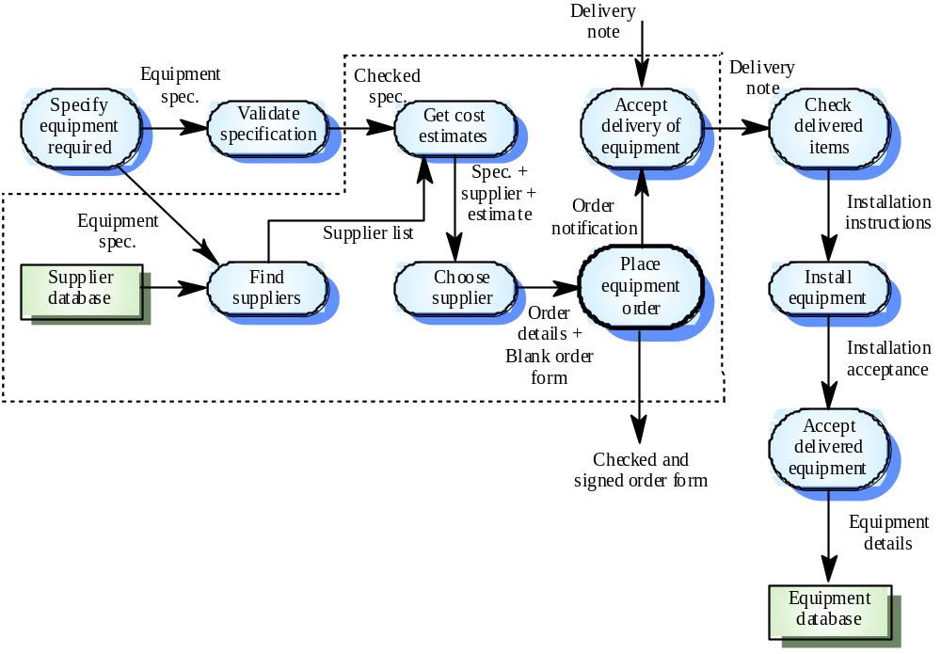
Equipment Procurement Process

Slide 44
Behavioral Models
Behavioral models are used to describe the overall behavior of a system
Two types of behavioral model are shown here
  Data processing models that show how data is processed as it moves through the system
  State machine models that show the systems response to events
Both of these models are required for a description of the system’s behavior

Slide 45
Data-processing Models
Data flow diagrams (DFDs) are used to model the system’s data processing
These show the processing steps as data flows through a system
Intrinsic part of many analysis methods
Simple and intuitive notation that customers can understand
Show end-to-end processing of data

Slide 46
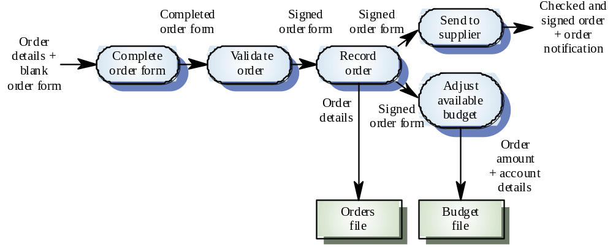
Order Processing DFD

Slide 47
Data Flow Diagrams
DFDs model the system from a functional perspective
Tracking and documenting how the data associated with a process is helpful to develop an overall understanding of the system
Data flow diagrams may also be used in showing the data exchange between a system and other systems in its environment

Slide 48
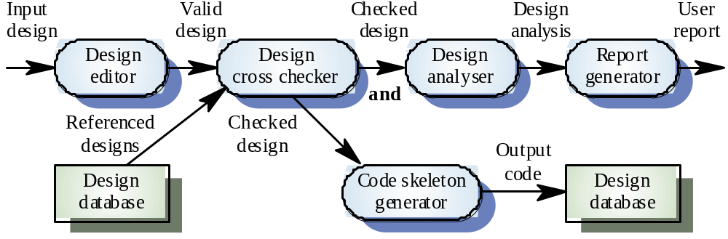
CASE Toolset DFD

Slide 49
#State Machine Models
These model the behavior of the system in response to external and internal events
They show the system’s responses to stimuli so are often used for modeling real-time systems
State machine models show system states as nodes and events as arcs between these nodes.
  When an event occurs, the system moves from one state to another
  State charts are an integral part of the UML

Slide 50
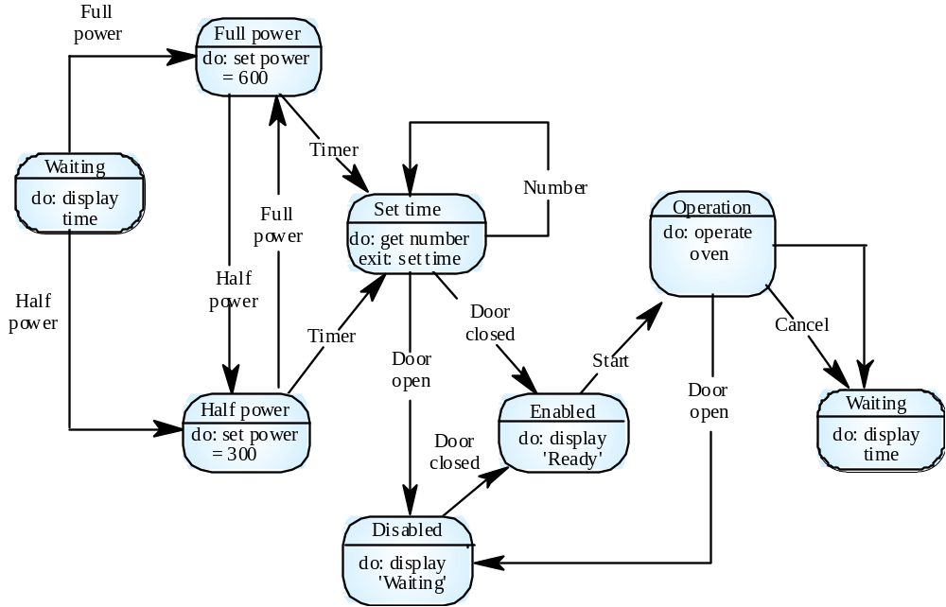
Microwave Oven Model

Slide 51
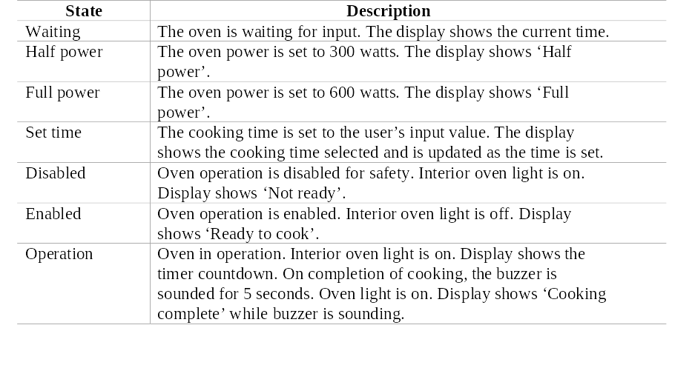
Microwave Oven State Description

Slide 52
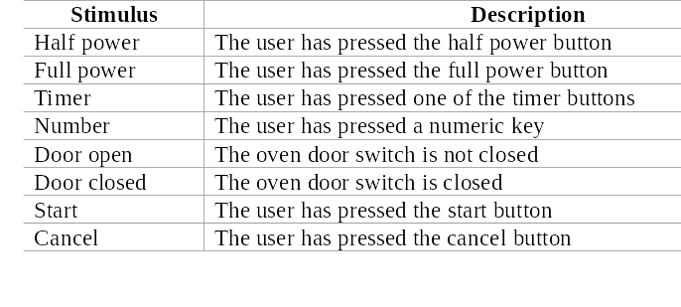
Microwave oven stimuli

Slide 53
State Charts
Allow the decomposition of a model into sub-models (see following slide)
A brief description of the actions is included following the ‘do’ in each state
Can be complemented by tables describing the states and the stimuli

Slide 54
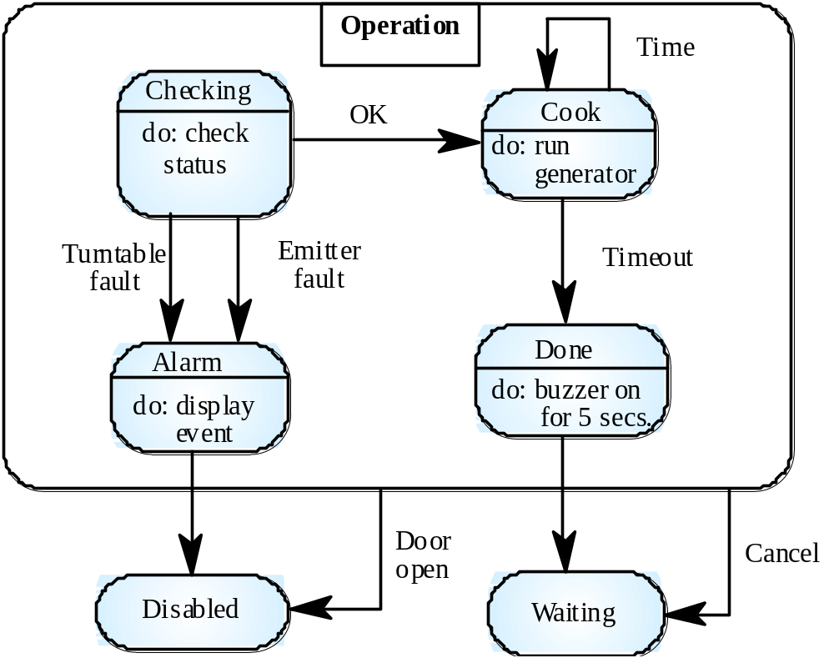
Microwave Oven Operation

Slide 55
Semantic Data Models
Used to describe the logical structure of data processed by the system
Entity-relation-attribute model
  entities in the system
  relationships between these entities
  entity attributes
Widely used in database design.
  readily implemented using relational databases
No specific notation provided in the UML but objects and associations can be used

Slide 56
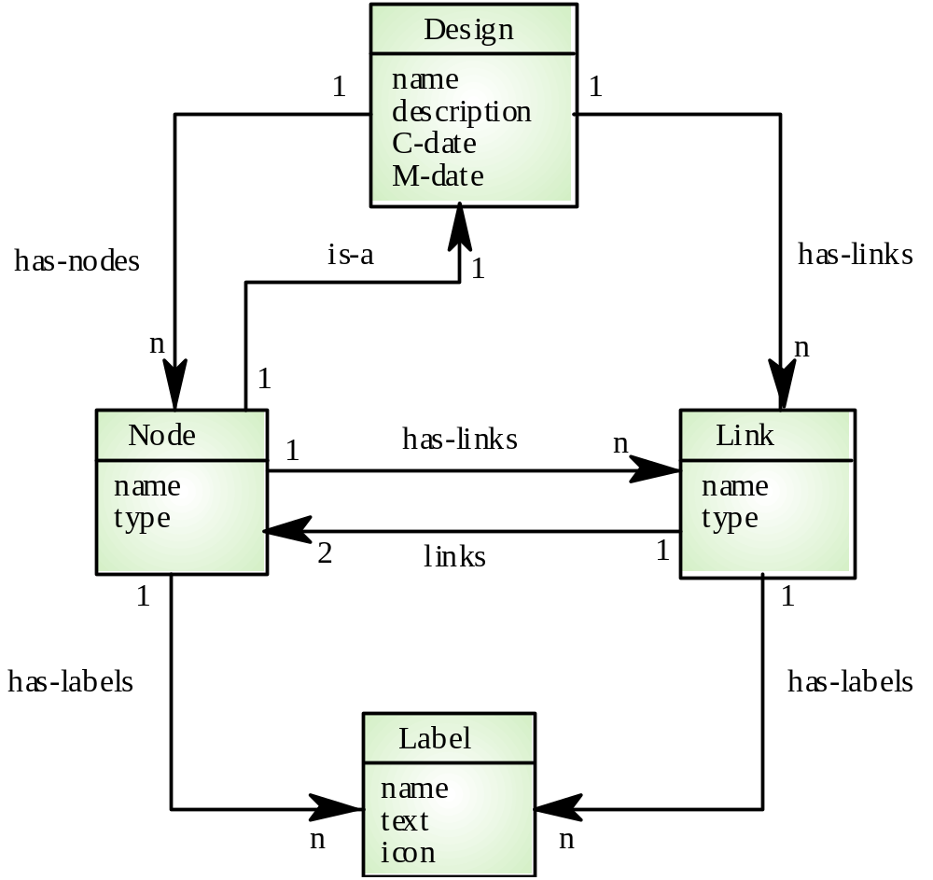
Software Design Semantic Model

Slide 57
Data Dictionaries
Data dictionaries are lists of all of the names used in the system models including descriptions of
  Entities
  Relationships
  Attributes
Advantages
  Support name management and avoid duplication
  Store of organizational knowledge linking analysis, design and implementation
Many CASE workbenches support data dictionaries

Slide 58
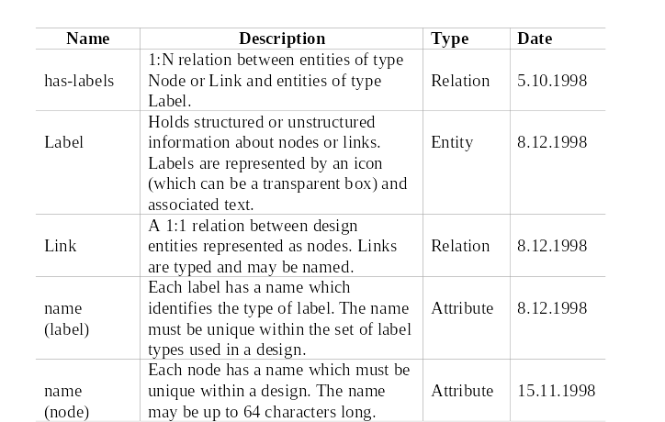
Data Dictionary Entries

Slide 59
Object Models
Object models describe the system in terms of object classes
An object class is an abstraction over a set of objects with common attributes and the services (operations) provided by each object
Various object models may be produced
  Inheritance
  Aggregation
  Interaction

Slide 60
Object Models
Natural ways of reflecting the real-world entities manipulated by the system
More abstract entities are more difficult to model using this approach
Object class identification is recognized as a difficult process requiring a deep understanding of the application domain
Object classes reflecting domain entities are reusable across systems

Slide 61
Inheritance Models
Organize the domain object classes into a hierarchy
Classes at the top of the hierarchy reflect the common features of all classes
Object classes inherit their attributes and services from one or more super-classes. these may then be specialized as necessary
Class hierarchy design is a difficult process if duplication in different branches is to be avoided

Slide 62
Multiple Inheritance
Rather than inheriting the attributes and services from a single parent class, a system which supports multiple inheritance allows object classes to inherit from several super-classes
Can lead to semantic conflicts where attributes/services with the same name in different super-classes have different semantics
Makes class hierarchy reorganization more complex

Slide 63
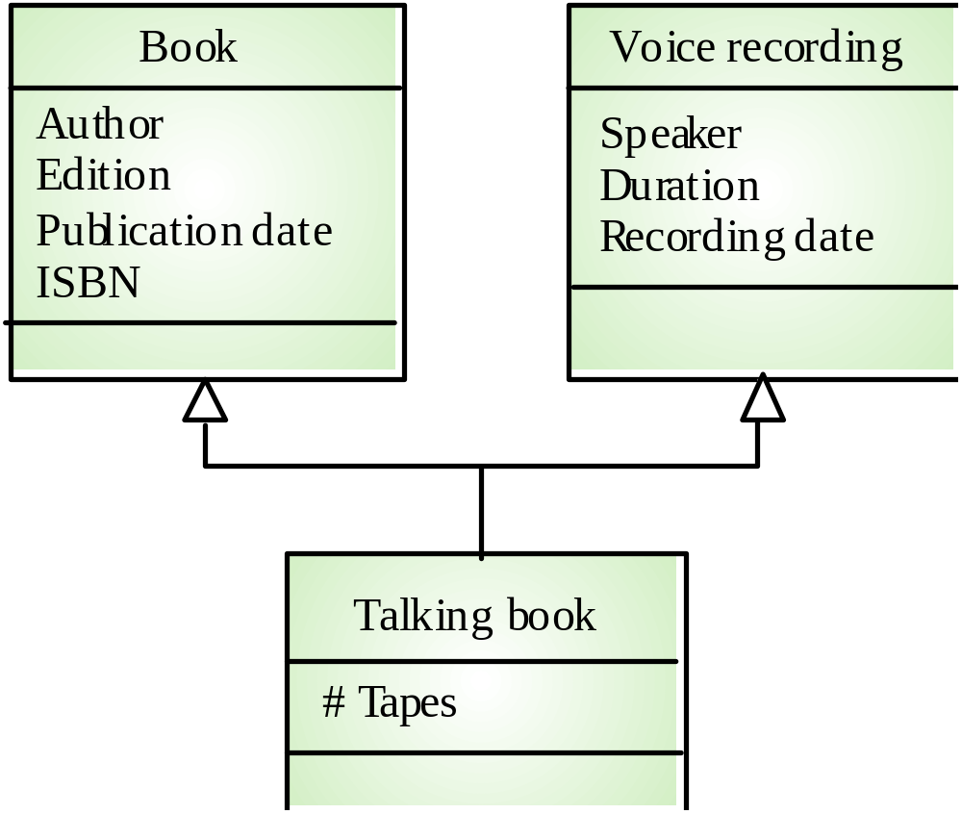
Multiple Inheritance

Slide 64
Object Aggregation
Aggregation model shows how classes which are collections are composed of other classes
Similar to the part-of relationship in semantic data models

Slide 65
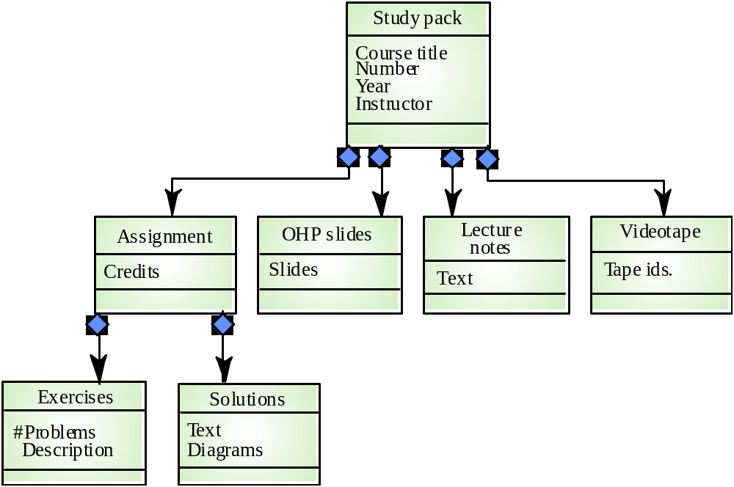
Object Aggregation

Slide 66
Object Behavior Modeling
A behavioral model shows the interactions between objects to produce some particular system behavior that is specified as a use-case
Sequence diagrams (or collaboration diagrams) in the UML are used to model interaction between objects

Slide 67
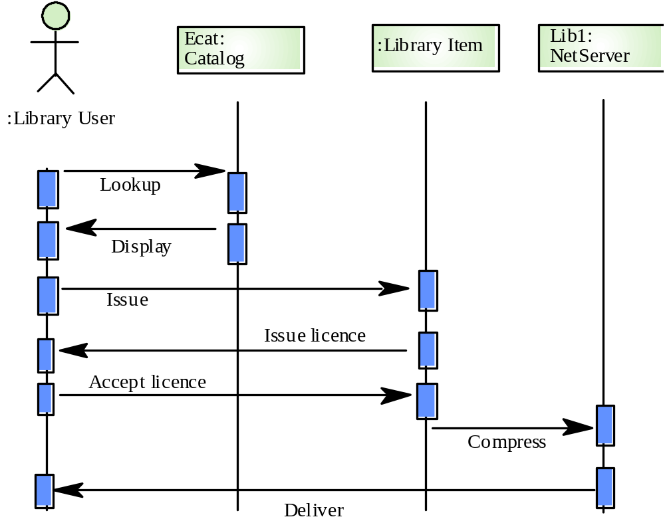
Issue of Electronic Items

Slide 68
CASE Workbenches
A coherent set of tools that is designed to support related software process activities such as analysis, design or testing
Analysis and design workbenches support system modeling during both requirements engineering and system design
These workbenches may support a specific design method or may provide support for a creating several different types of system model

Slide 69
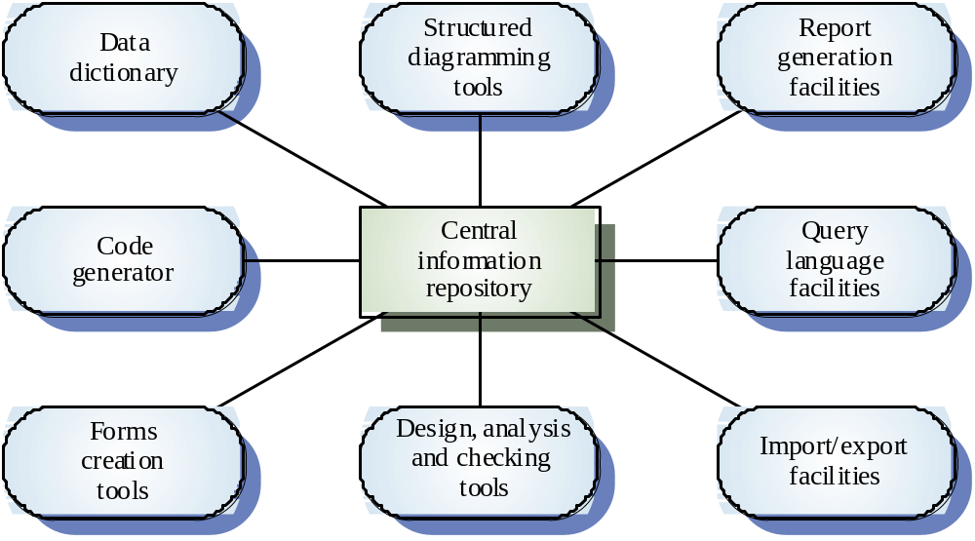
An Analysis and Design Workbench

Slide 70
Analysis Workbench Components
Diagram editors
Model analysis and checking tools
Repository and associated query language
Data dictionary
Report definition and generation tools
Forms definition tools
Import/export translators
Code generation tools

Slide 71
Key Points 1
A model is an abstract system view.
Complementary types of models provide different system information
  Context models show the position of a system in its environment with other systems and processes
  Data flow models may be used to model the data processing in a system
  State machine models model the system’s behavior in response to internal or external events

Slide 72
Key Points 2
Semantic data models describe the logical structure of data which is imported to or exported by the systems
Object models describe logical system entities, their classification and aggregation
Object models describe the logical system entities and their classification and aggregation
CASE workbenches support the development of system models

